Slide 1
Structure Learning of Bayesian Networks using Genetic Algorithms
Presenters:
Biniam T. Gebru
Mrinmoy Sarkar
Advisor: Dr. Abdollah Homaifar
Spring, 2017

Slide 2
Outline
Week I – Introduction
What are Bayesian Networks?
What is Structure Learning?
Problem Formulation
Week II – Solution Formulation
Summary of Various Approaches
Structure Learning using GA
Why GA?
Limitations
Implementation/Simulation details
Week III – Simulation Results
Structure learning results
Modifications or post-processing, if any
Week VI – Final Presentation

Slide 3
Today’s Outline
Week I – Introduction
Part I
What are Bayesian Networks?
Part II
What is Structure Learning?
Part III
Problem Formulation

Slide 4
Introduction
Motivation
Bayesian networks can readily handle incomplete data sets
Bayesian networks allow one to learn about causal relationships
Bayesian networks in conjunction with Bayesian statistical techniques facilitate the combination of domain knowledge and data
Bayesian methods in conjunction with Bayesian networks and other types of models offers an efficient and principled approach for avoiding the overfitting of data

Slide 5
Part I – Bayesian Networks (BNs)
Bayesian Networks
A Bayesian network is a structure that can be represented as a directed acyclic graph (DAG), and the data it contains can be seen from the following two points of view:
It allows a compact and modular representation of the joint distribution using the chain rule for Bayes network
It allows the conditional independence assumptions between vertices to be observed

Slide 6
Part I - BNs…
General Background
Bayesian Reasoning
Bayesian reasoning provides a probabilistic approach to inference. It is based on the assumption that the quantities of interest are governed by probability distributions and that optimal decisions can be made by reasoning about these probabilities together with observed data.
Probabilistic Reasoning
In ML, we are often interested in determining the best hypothesis from some space H, given the observed training data D.
One way to specify what is meant by the best hypothesis is to say that we demand the most probable hypothesis, given the data D together with any initial knowledge about the prior probabilities of the various hypotheses in H.
Bayes' Theorem
Bayes theorem is the cornerstone of Bayesian learning methods
It provides a way of calculating the posterior probability P(h | D), from the prior probabilities P(h), P(D) and P(D | h), as follows:

Slide 7
Part I - BNs…
Graphical Models
Two types:
Undirected
Consist of
a set of nodes
a set of edges
a potential for each clique, multiplied together to yield the distribution over variables
Directed
Consist of
a set of nodes
a set of edges
a conditional probability distribution for each node, conditioned on its parents, multiplied together to yield the distribution over variables
X₃
X₄
X₄
X₁
X₃
X₁
X₂
X₅
X₂
X₅

Slide 8
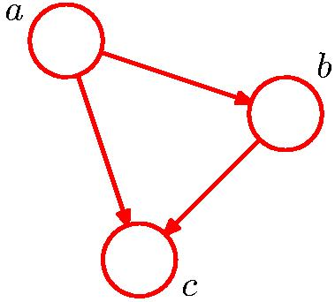
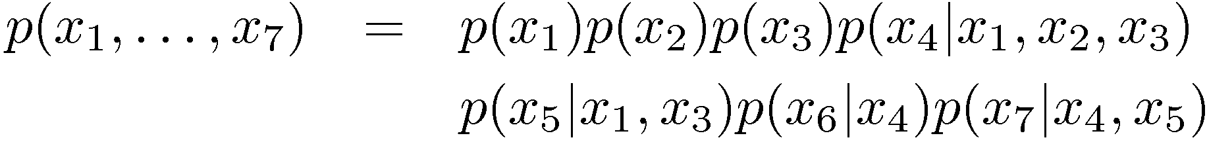
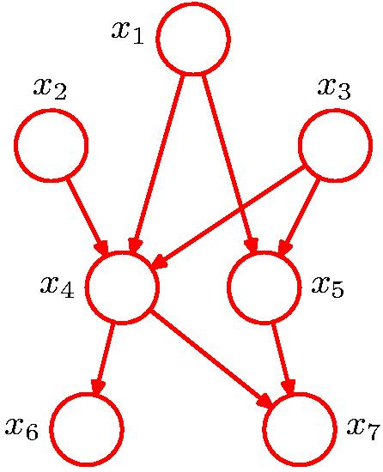
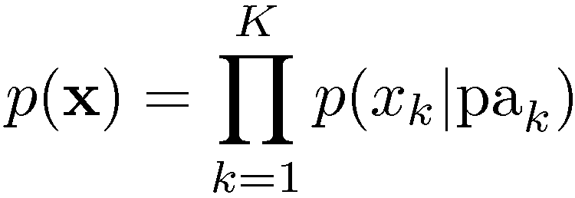
Part I - BNs…
General Factorization

Slide 9
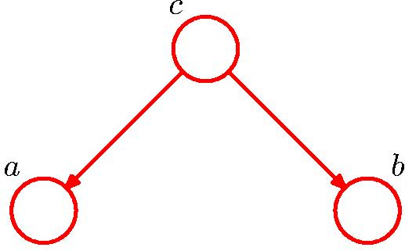

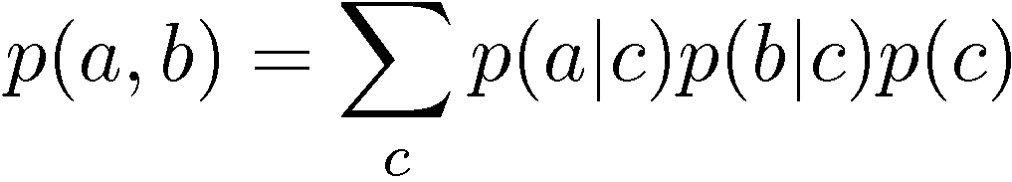

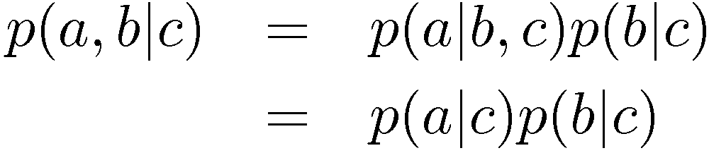
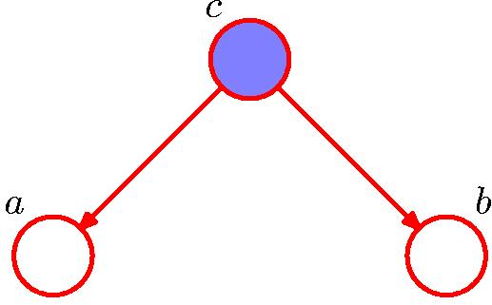

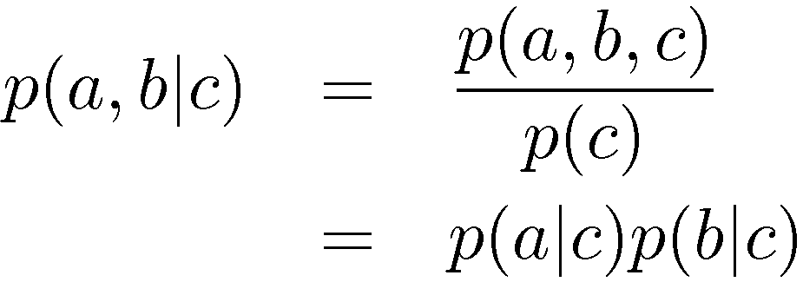
Part I - BNs…
Conditional Independence
a is independent of b given c
Equivalently
Notation

Slide 10
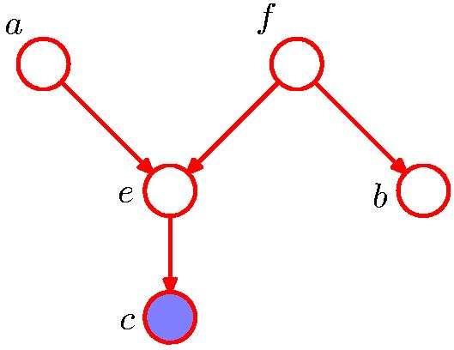

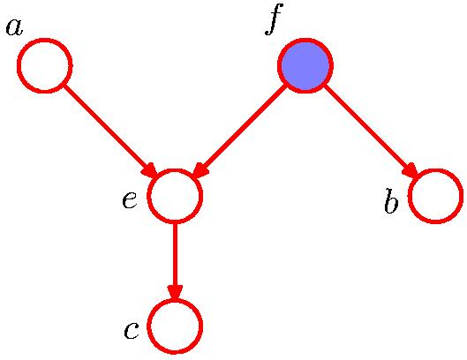


Part I - BNs…
D-Separation
A, B, and C are non-intersecting subsets of nodes in a directed graph.
A path from A to B is blocked if it contains a node such that either
the arrows on the path meet either head-to-tail or tail-to-tail at the node, and the node is in the set C, or
the arrows meet head-to-head at the node, and neither the node, nor any of its descendants, are in the set C.
If all paths from A to B are blocked, A is said to be d-separated from B by C.
If A is d-separated from B by C, the joint distribution over all variables in the graph satisfies

Slide 11
Part I - BNs…
Bayesian Networks….
Provide us with efficient representation and inference
Exploiting dependency structure makes it easier to represent and compute with probabilities
Represent causal dependencies among variables - causal graphical models
Express underlying causal structure
Causality simplifies inference
Using a representation in which the direction of causality is correct produces sparser graphs
Learning causal graphical models
Strength: how strong is a relationship?
Structure: does a relationship exist?
So what is Structure Learning?

Slide 12
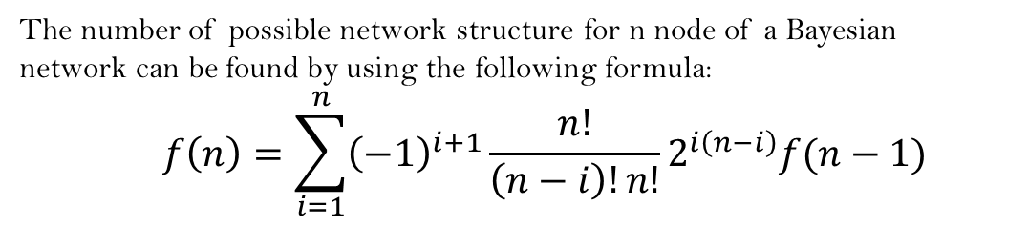
Part II – Structure Learning (SL)
The number of possible network structure for n node of a Bayesian network can be found by using the following formula:
$$f\left(n\right)=\sum_{i=1}^{n}{{\left(−1\right)}^{i+1}\frac{n!}{\left(n−i\right)!n!}2^{i\left(n−i\right)}f(n−1)}$$
Challenges:
The space of all Bayesian network structures is extremely large.
when searching through the network structures, we may end up with several equally good candidate structures.
The no. of different DAGs that can be generated for a given no. of nodes

Slide 13
Part II – SL…
General procedure in Structure Learning:
Constraint-based
Score-based

Slide 14
Score-based Structure learning
There are two component of score based learning:
a score function
a search procedure
Property of a score function:
It should balance the accuracy of a structure with the complexity of the structure.
It should be computationally tractable to evaluate.

Slide 15

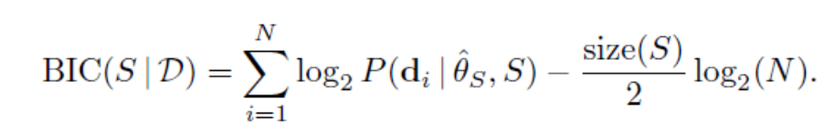
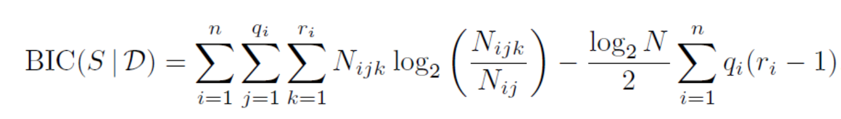
Score Function
The Bayesian Information Criterion(BIC):
If we furthermore assume that the cases are independent given the model, then
The calculation of the BIC score can be reduced to a counting problem:
Where, N_{ijk} denotes the number of cases in the database with X_{i} in its kth configuration and pa(X_{i}) in the jth configuration, r_{i} denote the number of states for variable X_{i}, q_{i} denote the number of configurations over the parents for X_{i} in S (if X_{i} does not have any parents then q_{i} = 1)

Slide 16
Score-based Structure learning(An example)
For structure a:
For structure a:
For structure b:
according to the BIC score we should choose structure a rather than structure b

Slide 17
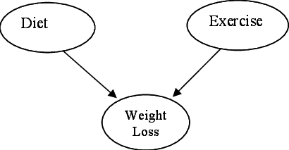
Part III – Problem Statement
Given:
A set of data example, sampled from a Bayesian Network
E.g.: Diet=Low, Exercise=No, Weight Loss = Low; Diet=High, Exercise=Yes, Weight Loss = High;
Unknown:
The Bayesian Network from which the data is sampled

Slide 18
What’s next?
Week II – Solution Formulation
Summary of Various Approaches
Structure Learning using GA
Why GA?
Limitations
Implementation/Simulation details

Slide 19
References
Pedro Larranaga, et al, Structure Learning of Bayesian Networks by Genetic Algorithms: A performance analysis of Control Parameters, IEEE Transactions of pattern Analysis and Machine Intelligence, Vol. 18, No. 9, Sept, 1996
Ben-Gal I., Bayesian Networks, Encyclopedia of Statistics in Quality and Reliability, Wiley & Sons, 2007
https://www.bayesserver.com/docs/introduction/bayesian-networks Retrieved on 18th March, 2018

